Slide 1

Local Search Techniques
Dr. Fayyaz ul Amir Afsar Minhas
PIEAS Biomedical Informatics Research Lab Department of Computer and Information Sciences Pakistan Institute of Engineering & Applied Sciences PO Nilore, Islamabad, Pakistan http://faculty.pieas.edu.pk/fayyaz/
CIS 530: Artifiical Intelligence
PIEAS Biomedical Informatics Research Lab

Slide 2
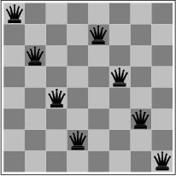
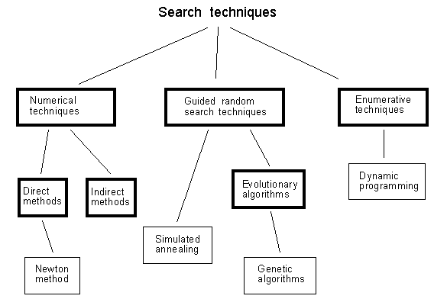
Local search and optimization
Previously: systematic exploration of search space.
Path to goal is solution
to problem
YET, for some problems path is irrelevant.
E.g 8-queens
Different algorithms can
be used
Local search
2

Slide 3
Local search and optimization
Local search = use single current state and move to neighboring states.
Advantages:
Use very little memory
Find often reasonable solutions in large or infinite state spaces.
Are also useful for pure optimization problems.
Find best state according to some objective function.
e.g. survival of the fittest as a metaphor for optimization.
3

Slide 4
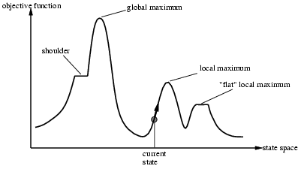
Local search and optimization
4

Slide 5
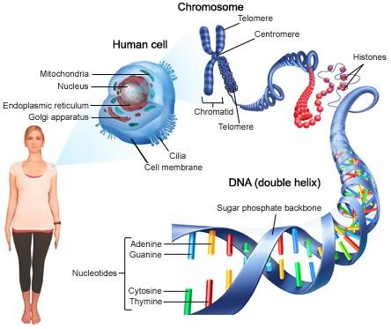
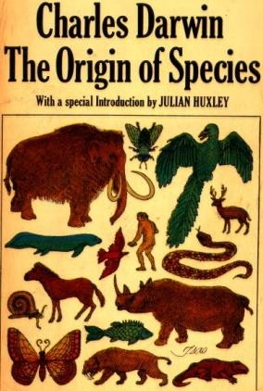
Genetic Algorithms
Based on ideas of Darwinian Evolution
Evolutionary computing evolved in the 1960s
GA’s were created by John Holland in mid 1970s

Slide 6
Genetic Algorithms
Coding of Solutions
Objective Function
Genetic Search
Problem
Solution
Genetic Operators
Problem Knowledge
Fitness Assignment
Reinsertion
Selection
Genetic Operations

Slide 7
Genetic algorithm
function GENETIC_ALGORITHM( population, FITNESS-FN) return an individual input: population, a set of individuals
FITNESS-FN, a function which determines the quality of the
individual
repeat
new_population ← empty set
loop for i from 1 to SIZE(population) do
x ← RANDOM_SELECTION(population, FITNESS_FN) y ← RANDOM_SELECTION(population, FITNESS_FN) child ← REPRODUCE(x,y)
if (small random probability) then child ← MUTATE(child )
add child to new_population population ← new_population
until some individual is fit enough or enough time has elapsed return the best individual
CIS 530: Artifiical Intelligence
PIEAS Biomedical Informatics Research Lab
19

Slide 8
Genetic Algorithm – Coding
Chromosomes are encoded by bit strings
Every bit string therefore is a solution but not necessarily the best solution
The way bit strings can code differs from problem to problem
– Either: sequence of on/off or the number 9
1
0
0
1

Slide 9
Genetic Algorithm – Fitness Assessment
Decoding of chromosome representation into decision variable domain
Objective function characterizing an individual’s performance
Fitness values assigned from raw performance measure of an individual

Slide 10
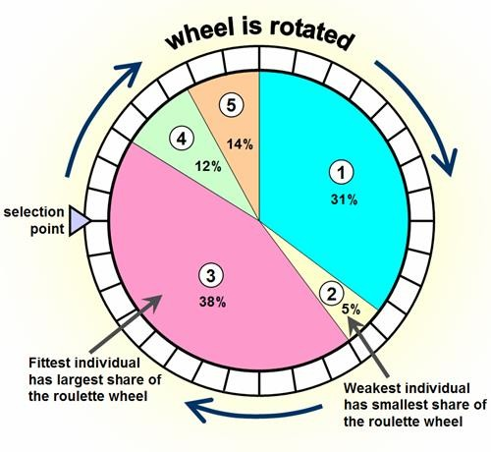
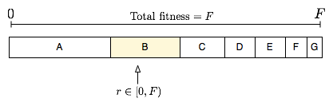
Genetic Algorithms - Selection
Roulette Wheel Selection (Fitness Proportional Selection)
Let the fitness of an individual x_{i} be f_{i}
Its probability of selection, p_{i} , is given by
f_{i}
p =
i
n
∑ ^{f}i
i=1
Individuals with higher fitness have more chances of being selected
Fitness value must always be positive
Procedure
Generate a random number between 0 and 1
Select the individual in whose range this number lies
Repeat until sufficient individuals are
selected

Slide 11
Genetic Algorithm – Cross Over
Recombination (cross-over) can when using bit strings schematically be represented as shown
Procedure
Form random pairs from the
selected individuals
Cross these pairs with
1
0
0
1
1
0
1
0
1
0
1
1
1
0
1
0
0
1
1
1
0
0
1
0
1
1
0
1
probability p
X
c
Generate a random number
between 0 and 1
If this number is less than p_{c}, perform cross over by choosing a random crossover site
Otherwise copy the parents as such

Slide 12
Genetic Algorithm – Mutation
Mutation prevents the algorithm to be trapped in a local minimum
In the bit string approach mutation is simply the flipping of one of the bits
Procedure
For each individual after cross over
Generate a random number
If this number is less than p_{m} then flip a
bit at a random position
Otherwise pass-on the individual as such
1
0
0
1
1
0
1
1
1
0
1
1
0
1

Slide 13
Generation of New Population
Replace all parents by using the output of the mutation

Slide 14
Simple Example
Maximize
f (x) = 1+ sin² (x),
x ∈[0,1)
Fitness Function
 |  |  | (0.25,2 | ) |  |  |  | (0.75,2 | )
2
1.8
1.6
f(x)
1.4
1.2
1
0
0.1 0.2 0.3 0.4 0.5 0.6 0.7 0.8 0.9
x
1

Slide 15
Simple Example: GA Problem Formulation
Coding
Six bit unsigned fixed point quantization
Word-length = 6
Fraction – length = 6
(000000)₂ = 0₁₀
(111111)₂ = 1₁₀
Optimum points are:
– x₁* = 0.75 = 110000
– x₂* = 0.25 = 010000
Fitness Evaluation
Convert number to phenotype
– Use
f (x) = 1+ sin² (x),
x ∈[0,1)
Selection: Roulette Wheel Selection
Cross-Over: p_{c} = 0.8, Simple Single Point Cross-Over
Mutation: p_{m} = 0.01, Single bit mutation
Termination: Based on limit on number of Generations (1000)
Generation of Initial Population: Bit representation of random numbers
between (0,0.15) and (0.5,0.65)
Population Size: n = 200

Slide 16
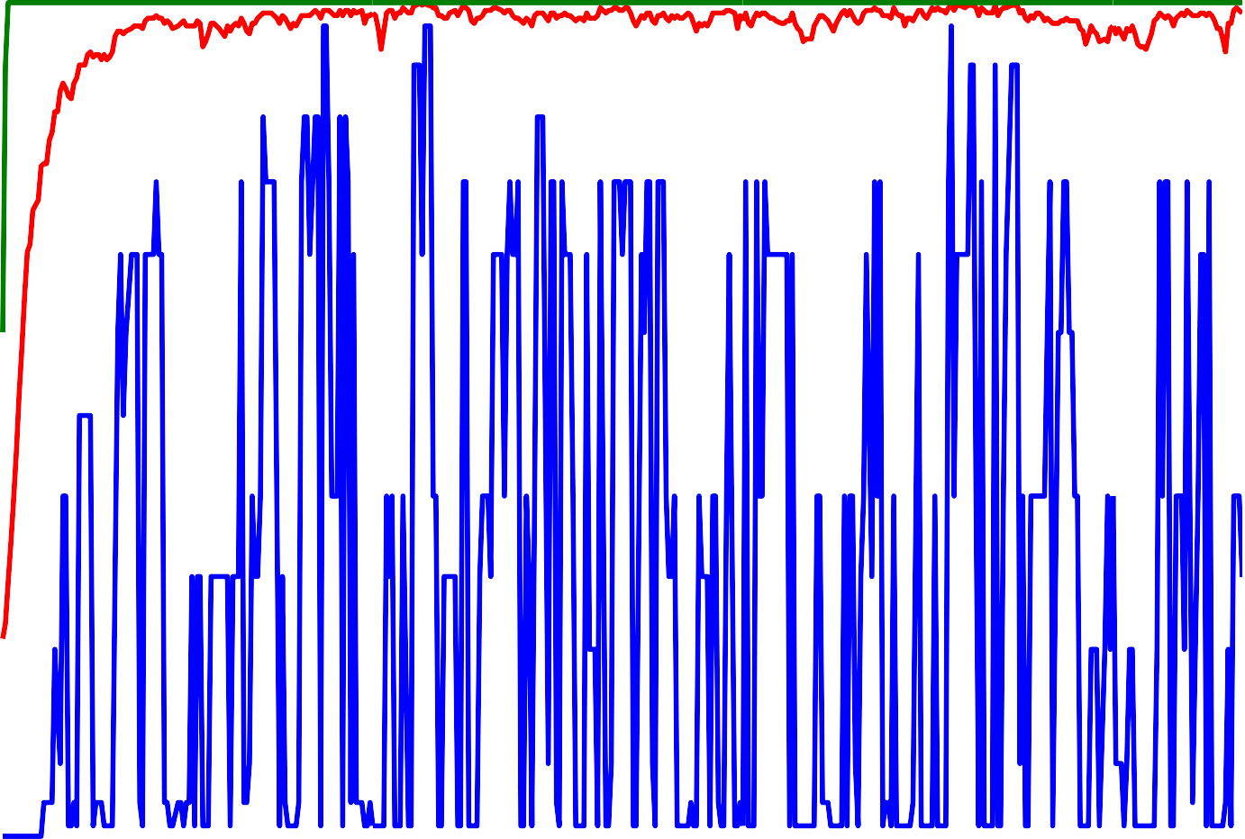
Performance of GA
 |  |  |  |  |  |  | Avg. Fitness Max. Fitness Min. Fitness
2
1.9
1.8
1.7
1.6
1.5
1.4
1.3
1.2
1.1
1
Fitness Value
0
50
100
150 200
Generations
250
300
350
400
CIS 530: Artifiical Intelligence PIEAS Biomedical Informatics Research Lab 29

Slide 17
Advantages of GA
It search the population of points in parallel, not a single point.
It does not require any derivative information or other knowledge except an objective function
It uses probabilistic transition rules.
It can provide more than one potential solutions to a problem.
17

Slide 18
Application Areas of GA
Optimization
Automatic Programming
Machine and Robot Learning
Economic Models
Image Processing and Pattern Recognition
Control Engineering
18

Slide 19
Variations & Enhancements in GA
19

Slide 20
Variations in Simple Genetic Algorithm
The SGA can be changed by changing
Encoding of the chromosomes
Selection Strategy
Reinsertion Strategy
Genetic Operators
Enhancements to SGA
Introducing Diversity
Handling constraints
20

Slide 21

Variations in Chromosome Encoding
Binary Encoding
Most common and most frequently used encoding scheme
Every chromosome is a string of ones (1s) and zeros (0s)
Gives many possible chromosomes even with a small number of alleles
It may not be natural for many problems and corrections must be made after crossover and mutation
21

Slide 22

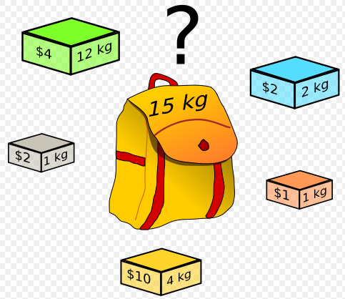
Variations in Chromosome Encoding…
Binary Encoding…
Example
The Knapsack Problem
There are things with given value and size. The knapsack has given capacity. The problem is to select things to maximize the value of things in the knapsack while keeping the capacity of the knapsack constant
GA Solution
Each bit says if the corresponding thing is in the knapsack
1 | 1 | 0 | 1 | 1
22

Slide 23

Variations in Chromosome Encoding…
Permutation Encoding
Can be used in ordering problems such as the Traveling Salesman Problem (TSP) or task ordering problem
Every chromosome is a string of numbers, which represents number in a sequence
Special types of crossover and mutation corrections must be made to leave the chromosome consistent (i.e. have real sequence)
23

Slide 24
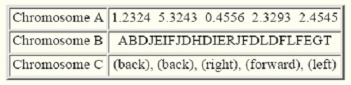
Variations in Chromosome Encoding…
Value Encoding
Direct value encoding (e.g. real numbers) can be used in problems
Every chromosome is a string of some values which represent some connection to the problem being studied
– New mutation and crossover operators needed
24

Slide 25
Variations in Selection
Steady State Selection
No particular method of selecting parents
Main idea is that big part of chromosomes should survive to the next generations
A few good chromosomes are selected for creating new offspring
No probabilistic selection
Roulette Wheel Selection
Already Discussed
Faces problems when fitness values of chromosomes differ very much
Fitness scaling required to enable selection of some of the ‘non-best’ chromosomes to maintain diversity
25

Slide 26
Variations in Selection…
Rank Based Selection
– Rank selection ranks first ranks the chromosomes and then assigns fitness to each of the N chromosomes based on its rank
Chromosome-1 Chromosome-2 Chromosome-3 Chromosome-4
The worst chromosome will have fitness = 1
The best chromosome will have fitness = N
Apply roulette wheel selection on
these values
Chromosome-1 Chromosome-2 Chromosome-3 Chromosome-4
May lead to more diverse solutions
May lead to slower
convergence
47
PIEAS Biomedical Informatics Research Lab
CIS 530: Artifiical Intelligence

Slide 27
Variations in Operators: Recombination
Real valued Recombination
Discrete Recombination
Intermediate Recombination
Binary valued Recombination
Single point Crossover
Multi-point Crossover
Uniform Crossover

Slide 28
Discrete Recombination
Individual 1 | 9 | 12
Individual 2 | 33 | 5
Offspring 1 | 33 | 12
Offspring 2 | 9 | 5

Slide 29
Effect of Discrete Recombination
x₂
Possible Offspring
Parents
x₁

Slide 30
Intermediate Recombination
O₁ = P₁ + α (P₂ - P₁) α ∈ [-0.25,1.25]
P₁
P₂
 | Area of Parents
Possib | le Area of Offspring
-0.25
0
1
1.25

Slide 31
Single Point Crossover
Choose randomly crossover pt. c ∈[1,N_{b}]
P₁ = 0 0 0 1 1 1 1 0
P₂ = 1 0 1 1 0 0 1 1
O₁ = 0 0 0 1 0 0 1 1
O₂ = 1 0 1 1 1 1 1 0

Slide 32
Multi-point Crossover
m crossover points c_{i} ∈[1,N_{b}], i=1,…,m
P₁ = 0 0 0 1 1 1 1 0
P₂ = 1 0 1 1 0 0 1 1
O₁ = 0 0 0 1 0 1 1 0
O₂ = 1 0 1 1 1 0 1 1

Slide 33
Uniform Crossover
Every locus a potential crossover point
P₁ = 0 0 0 1 1 1 1 0
P₂ = 1 0 1 1 0 0 1 1
M₁ = 0 1 1 0 0 1 0 1
M₂ = 1 0 0 1 1 0 1 0
O₁ = 1 0 0 1 0 1 1 0
O₂ = 0 0 1 1 1 0 1 1

Slide 34
Variations in Operators: Mutation
Real valued Mutation
Binary Mutation

Slide 35
Real Valued Mutation
Mutated Variable = Variable ± R δ
– R = Range of variable
The radius of mutation can be decreased as the generations proceed to avoid loosing the good solutions
x₂
After Mutation
Before Mutation
x₁

Slide 36
Binary Valued Mutation
Changing the variable value at mutation site selected randomly
O = 1 0 1 1 1 1 1 0
O_{m} = 1 0 1 1 0 1 1 0

Slide 37
Variations in Reinsertion Strategies
Global Reinsertion
Local Reinsertion

Slide 38




Global Reinsertion
Different Schemes
produce as many offspring as parents and replace all parents
produce less offspring than parents and replace parents uniformly at random
produce less offspring than parents and replace only worst
parents
produce more offspring than parents and reinsert only best offspring
Parents Offspring
Best Individual
Worst Individual
Insertion of Best 3 Offspring
New Population

Slide 39
Local reinsertion
Select a neighborhood and reinsertion take place only in that specified neighborhood

Slide 40
Some Observations on Genetic Algorithms
Local vs. Global Optima
No-Free-Lunch Theorem holds here
Chances of convergence to Global Optima can be increased through maintaining population diversity (by niche-penalty or increased mutation rate)
Dynamic Data
Operating on dynamic data sets is difficult, as genomes begin to converge early on towards solutions which may no longer be valid for later data.
An effective approach is not to maintain any original parents in the population parents, i.e., new parents are selected only from offspring
GAs cannot effectively solve problems in which the only fitness measure is right/wrong

Slide 41
Some Observations on Genetic Algorithms…
For specific optimization problems and problem instantiations, simpler optimization algorithms may find better solutions than genetic algorithms (given the same amount of computation time).
As with all current machine learning problems it is worth tuning the parameters such as mutation probability, recombination probability and population size to find reasonable settings for the problem class being worked on.
A very small mutation rate may lead to genetic drift (which is non-ergodic in nature).
A mutation rate that is too high may lead to loss of good solutions unless there is elitist selection.
A recombination rate that is too high may lead to premature convergence of the genetic algorithm.
There are theoretical but not yet practical upper and lower bounds for these parameters that can help guide selection.

Slide 42
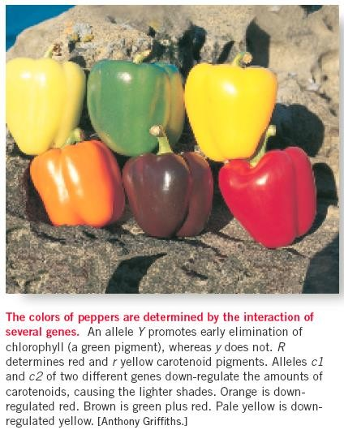
Some Observations on Genetic Algorithms…
The Epistasis Dogma
Epistasis, in genetics, is defined as the interaction amongst genes
In GA, it means that the alleles interact to determine the fitness of the individual
GA is most effective in problems
that involve medium epistasis
Hill Climbing
Genetic Algorithms
Random Search
0% Epistasis
100% Epistasis

Slide 43
Some Applications of Genetic Algorithms
Artificial Creativity
Automated design, including research on composite material design and multi-objective design of automotive components
Automated design of mechatronic systems
Automated design of industrial equipment
Automated design of sophisticated trading systems in the financial sector.
Calculation of Bound states and Local-density approximations.
Chemical kinetics
Configuration applications,
Container loading optimization.
Code-breaking
Design of water distribution systems.
Distributed computer network topologies.
Electronic circuit design, known as Evolvable hardware.
File allocation for a distributed system.
Game Theory Equilibrium Resolution.
Learning Robot behavior using Genetic Algorithms.
Learning fuzzy rule base using genetic algorithms.
Linguistic analysis, including Grammar Induction and other aspects of Natural Language Processing (NLP) such as word sense disambiguation.

Slide 44
Some Applications of Genetic Algorithms…
Marketing Mix Analysis
Mobile communications infrastructure optimization.
Molecular Structure Optimization (Chemistry).
Multiple population topologies and interchange methodologies.
Optimization of data compression systems, for example using wavelets.
Protein folding and protein/ligand docking.
Plant floor layout.
Representing rational agents in economic models such as the cobweb model.
Scheduling applications, including job-shop scheduling. The objective being to schedule jobs in a sequence dependent or non-sequence dependent setup environment in order to maximize the volume of production while minimizing penalties such as tardiness.
Selection of optimal mathematical model to describe biological systems.
Software engineering
Solving the machine-component grouping problem required for cellular manufacturing systems.
Hardware bug finding during the Validation process.

Slide 45
Some Applications of Genetic Algorithms…
Tactical asset allocation and international equity strategies.
Timetabling problems, such as designing a non-conflicting class timetable for a large university.
Training artificial neural networks when pre-classified training examples are not readily obtainable
Traveling Salesman Problem.
Control Applications
Robotic Path Planning

Slide 46
End of Lecture
The law of heredity is that all undesirable traits come from the other parent.
Anon.
CIS 530: Artifiical Intelligence
PIEAS Biomedical Informatics Research Lab

